Slide 1

Bank
of CLI
Presented by :
Boone Wilder
Sept 25, 2026

Slide 2

Contents
01.
Project Overview
02.
Technology
03.
04.
08.
Architecture
Atomicity
Consistency
05.
06.
07.
Logging
Durability
08.
04.
Isolation
Testing
Demo

Slide 3

Project Overview
Bank of CLI
Bank of CLI - A functional banking application that runs entirely within the terminal.
Features a simple CLI that allows the user to interact with the banking services such as depositing, withdrawing, or transferring money.

Slide 4
Technology
Language: Java
Build Tool: Maven
Database: Postgre
Testing: JUnit 5
Logging: Logback & SLF4J
Version Constrol:
Git & Github

Slide 5
Architecture
Handles terminal interaction through receiving commands and calling service methods to display output.
Domain
Layer
API
Layer
Contains
classes relating to the tables for processing
Handles most logic and evaluation. This layer receives calls from the API Layer and sends calls to the Persistence Layer
Business
Layer
Persistence
Layer
Handles most logic and evaluation. This layer receives calls from the API Layer and sends calls to the Persistence Layer

Slide 6
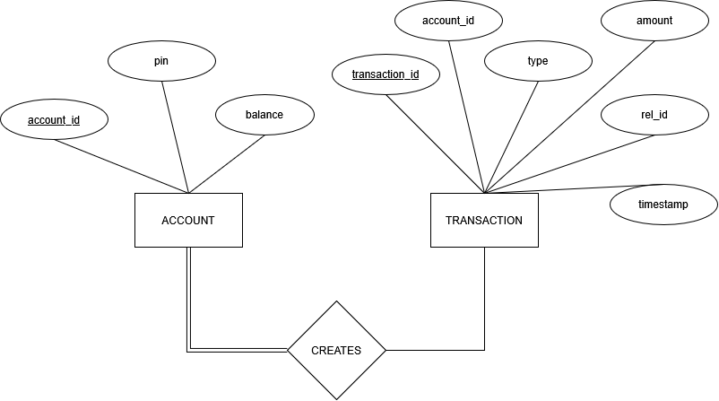
Entity Relationship Diagram

Slide 7
Acid Principals
Atomicity
This application insures that all operations inside of a transaction are evaluated together; all of them pass or all of them fail.
This is to ensure that operations are never partially completed, leaving errors and vulnerabilities in the system.
Ex. Transaction method

Slide 8
Acid Principals
Consistency
Consistency is applied throughout the application through testing and validation.
The majority of the validation is handled in the Business Layer after a method is called.
Ex. Error handling from service layer

Slide 9
Acid Principals
Isolation
This application implements isolation by structuring transactions to not interfere with each other.
Each transaction is a command followed by a number of method calls and returns, that occur sequentially
The MVCC feature of PostgreSQL helps maintain isolation.

Slide 10
Acid Principals
Durability
Durability is implemented through commiting successful transactions to the database.
No data will be lost through this as the state of the database will persist through the event of an error or power failure in the application.

Slide 11
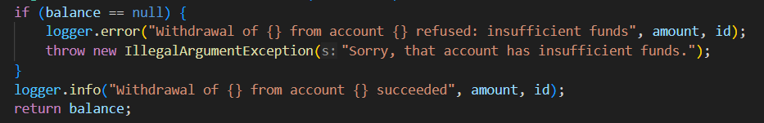
Logging
Logback and SFL4J
Positive and Negative tests

Slide 12
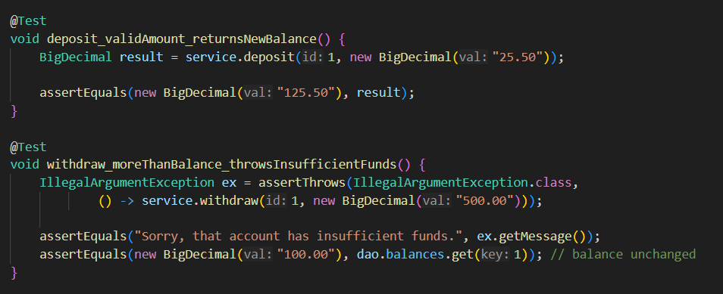
Testing
JUnit 5

Slide 13
Demo

